Slide 1
Module 1 - Agents

Slide 2
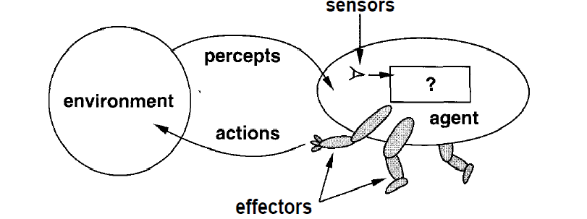
What is an Agent?
An entity that interacts with its environment
  perception through sensors
  actions through effectors or actuators

Slide 3



Slide 4
Examples of Agents
  human agent
    eyes, ears, skin, taste buds, etc. for sensors
    hands, fingers, legs, mouth, etc. for actuators
      powered by muscles
  robot
    camera, infrared, bumper, etc. for sensors
    grippers, wheels, lights, speakers, etc. for actuators
      often powered by motors
  software agent
    functions as sensors
      information provided as input to functions in the form of encoded bit strings or symbols
    functions as actuators
      results deliver the output

Slide 5
Software Agents
The term "agent" describes a software abstraction, an idea, or a concept, similar to OOP terms such as methods, functions, and objects.
The concept of an agent provides a convenient and powerful way to describe a complex software entity that is capable of acting with a certain degree of autonomy in order to accomplish tasks on behalf of its host.
unlike objects, which are defined in terms of methods and attributes, an agent is defined in terms of its behavior

Slide 6
Software Agents
Also referred to as “softbots”
live in artificial environments where computers and networks provide the infrastructure
may be very complex with strong requirements on the agent
  World Wide Web, real-time constraints,
natural and artificial environments may be merged
  user interaction
  sensors and actuators in the real world
    camera, temperature, arms, wheels, etc.

Slide 7
Agents and Environments
An agent perceives its environment through sensors
  The complete set of inputs at a given time is called a percept.
  Percept sequence is the complete history of everything the agent has ever perceived.
  The current percept, or a sequence of percepts may influence the actions of an agent
  Set of inputs→ Percept sequence →action
It can change the environment through actuators
  an operation involving an actuator is called an action
  actions can be grouped into action sequences

Slide 8
Agents and Their Actions
A rational agent does “the right thing”
  the action that leads to the best outcome under the given circumstances
An agent function maps percept sequences to actions
  abstract mathematical description
  F: P->A
An agent program is a concrete implementation of the respective function
  it runs on a specific agent architecture (“platform”)
  Agent : architecture+program
Problems:
  what is “ the right thing”
  how do you measure the “best outcome”

Slide 9
Performance of Agents
Criteria for measuring the outcome and the expenses of the agent
  often subjective, but should be objective
  task dependent
  time may be important

Slide 10
Example
47% of Americans pay no federal income tax. These people believe they are victims and would never vote for a Republican candidate.“
In this quote ,the first statement is objective. It is a measurable fact that 47% of Americans do not pay federal income taxes.
However, the second statement is Romney's personal point of view and is entirely subjective.
Apple only allows apps that the company has approved to be installed on iOS devices. The company does not care about openness of their platform.

Slide 11
Performance Evaluation Examples
vacuum agent
It is the criteria, which determines how successful an agent is.
  number of tiles cleaned during a certain period
    based on the agent’s report, or validated by an objective authority
    doesn’t consider expenses of the agent, side effects
      energy, noise, loss of useful objects, damaged furniture, scratched floor
    might lead to unwanted activities
      agent re-cleans clean tiles, covers only part of the room, drops dirt on tiles to have more tiles to clean, etc.

Slide 12
Rational Agent
Selects the action that is expected to maximize its performance
Its built-in knowledge base
  based on a performance measure
  Based on the success of the agents behavior
depends on the percept sequence, background knowledge, and feasible actions
Selection of performance is not always easy.
Example :vacuum agent : one does the job of cleaning.
Second cleans energetically but takes long break.
2. Reckless life with high and lows or a safe but human existence.

Slide 13
Rationality
Rationality of an agent depends on the following four factors −The performance measures, which determine the degree of success.
Agent’s Percept Sequence till now.
The agent’s prior knowledge about the environment.
The actions that the agent can carry out.
A rational agent always performs right action, where the right action means the action that causes the agent to be most successful in the given percept sequence.
The problem the agent solves is characterized by Performance Measure, Environment, Actuators, and Sensors (PEAS).

Slide 14
Rational Agent Considerations
Performance measure that defines the criterion of success
Complete perceptual history (percept sequence)
Background knowledge
  especially about the environment
    dimensions, structure, basic “laws”
  task, user, other agents
Feasible actions
  capabilities of the agent

Slide 15
Omniscience
Difference between rationality and omniscience.
An Omniscient agent knows the actual outcome of its action and can act accordingly. But this is impossible in reality.
A rational agent is not omniscient
  it doesn’t know the actual outcome of its actions
  it may not know certain aspects of its environment
Rationality takes into account the limitations of the agent
  percept sequence, background knowledge, feasible actions
  it deals with the expected outcome of actions

Slide 16
Environments
Determine to a large degree the interaction between the “outside world” and the agent
  The “outside world” is not necessarily the “real world” as we perceive it
    it may be a real or virtual environment the agent lives in
In many cases, environments are implemented within computers
  They may or may not have a close correspondence to the “real world”

Slide 17
PEAS Description Template
Used for high-level characterization of agents
Performance Measures
Environment
Actuators
Sensors
How well does the agent solve the task at hand? How is this measured?
Important aspects of the surroundings beyond the
control of the agent:
Determine the actions the agent can perform.
Provide information about the current state of the environment.

Slide 18
VacBot PEAS Description
Performance Measures
Environment
Actuators
Sensors
cleanliness of the floor
time needed
energy consumed
grid of tiles
dirt on tiles
possibly obstacles, varying amounts of dirt
movement (wheels, tracks, legs, ...)
dirt removal (nozzle, gripper, ...)
position (tile ID reader, camera, GPS, ...)
dirtiness (camera)

Slide 19
StudentBot PEAS Description
Performance Measures
Environment
Actuators
Sensors
grade
time spent studying
career success
classroom, university, universe
human actuators
human sensors

Slide 20
Automated Taxi Driver
PEAS Description
Performance Measures
Environment
Actuators
Sensors
Safe, fast, legal, comfortable trip,
maximize profits
Roads, other traffic, pedestrians, customers
Steering, Accelerator, Brake, horn
Cameras, GPS, speedometer, odometer…

Slide 21
Medical Diagnosis System
PEAS Description
Performance Measures
Environment
Actuators
Sensors
Healthy patient, minimize costs, lawsuits
Patient, hospital, staff
Display questions, diagnoses, referrals
Keyboard entry of symptoms, patient answers

Slide 22
Environment Properties or Types of Environments
Fully observable vs. Partially observable: An agent's sensors give it access to the complete state of the environment at each point in time.
  sensors capture all relevant information from the environment.
  the agent need not maintain any internal state to keep track of the world.
  An environment might be partially observable because of noisy and inaccurate sensors or because parts of the state are simply missing from the sensor data
  Playing chess with clock or without clock whereas taxi driver driving a car is partially observable because automated taxi cannot see what other drivers are thinking

Slide 23
Environment Properties or Types of Environments
Deterministic vs. Stochastic (non-deterministic) : The next state of the environment is completely determined by the current state and the action executed by the agent. (If the environment is deterministic except for the actions of other agents, then the environment is strategic)
  changes in the environment are predictable
  an agent need not worry about uncertainty in a fully observable, deterministic environment.
  Taxi driving is clearly stochastic in this sense, because one can never predict the behavior of traffic exactly; moreover, one’s tires blow out and one’s engine seizes up without warning.
  The vacuum world is deterministic, but variations can include stochastic elements such as randomly appearing dirt and an unreliable suction mechanism
  Playing chess with clock or without clock strategic and taxi driver is not .

Slide 24
Environment Properties or Types of Environments
episodic vs. sequential (non-episodic) : The agent's experience is divided into atomic "episodes" (each episode consists of the agent perceiving and then performing a single action), and the choice of action in each episode depends only on the episode itself.
  independent perceiving-acting episodes
  For example, an agent that has to spot defective parts on an assembly line bases each decision on the current part, regardless of previous decisions; moreover, the current decision doesn’t affect whether the next part is defective.
  In sequential environments, the current decision could affect all future decisions.
  Chess and taxi driving are sequential: in both cases, short-term actions can have long-term consequences.
  Episodic environments are much simpler than sequential environments because the agent does not need to think ahead.

Slide 25
Environment Properties or Types of Environments
static vs. dynamic : If the environment can change while an agent is deliberating, then we say the environment is dynamic for that agent; otherwise, it is static. (The environment is semi-dynamic if the environment itself does not change with the passage of time but the agent's performance score does)
Static environments are easy to deal with because the agent need not keep looking at the world while it is deciding on an action, nor need it worry about the passage of time.
Dynamic environments, are continuously asking the agent what it wants to do; if it hasn’t decided yet, that counts as deciding to do nothing.
If the environment itself does not change with the passage of time but the agent’s performance score does, then we say the environment is semi dynamic
  no changes while the agent is “thinking”
  Playing chess with clock is semi static and Playing chess without clock is not static and taxy driver dynamic .

Slide 26
Environment Properties or Types of Environments
discrete vs. continuous : A limited number of distinct, clearly defined percepts and actions.
  limited number of distinct percepts/actions
  Playing chess with clock 0r without clock is discrete ,taxy driver is continuous
single vs. multiple agents: An agent operating by itself in an environment.
  interaction and collaboration among agents
  competitive, cooperative
  Playing chess with clock 0r without clock ,taxy is not a single agent
The environment type largely determines the agent design
The real world is (of course) partially observable, stochastic, sequential, dynamic, continuous, multi-agent

Slide 27
Structure of Intelligent Agents
Agent = Architecture + Program
Architecture
  operating platform of the agent
    computer system, specific hardware, possibly OS functions
Program
  function that implements the mapping from percepts to actions

Slide 28
Agent Programs
The emphasis is on programs that specify the agent’s behavior through mappings from percepts to actions
  less on environment and goals
Agents receive one percept at a time
  they may or may not keep track of the percept sequence
Performance evaluation is often done by an outside authority, not the agent
  more objective, less complicated
  can be integrated with the environment program

Slide 29
Environment Programs
Environment simulators for experiments with agents
  gives a percept to an agent
  receives an action
  updates the environment
often divided into environment classes for related tasks or types of agents
the environment frequently provides mechanisms for measuring the performance of agents

Slide 30
From Percepts to Actions
Mapping from percept sequences to actions
  If an agent only reacts to its percepts, a table can describe this mapping
  instead of a table, a simple function may also be used
    can be conveniently used to describe simple agents that solve well-defined problems in a well-defined environment
      e.g. calculation of mathematical functions

Slide 31
Agent or Program
Our criteria so far seem to apply equally well to software agents and to regular programs
Autonomy
  agents solve tasks largely independently
  programs depend on users or other programs for “guidance”
  autonomous systems base their actions on their own experience and knowledge
  requires initial knowledge together with the ability to learn
  provides flexibility for more complex tasks

Slide 32
Skeleton Agent Program
Basic framework for an agent program
function SKELETON-AGENT(percept) returns action
static: memory
memory := UPDATE-MEMORY(memory, percept)
action := CHOOSE-BEST-ACTION(memory)
memory := UPDATE-MEMORY(memory, action)
return action

Slide 33
Table Agent Program
Agent program based on table lookup
function TABLE-DRIVEN-AGENT(percept) returns action
static: percepts // initially empty sequence*
      table // indexed by percept sequences
      // initially fully specified
append percept to the end of percepts
action := LOOKUP(percepts, table)
return action

Slide 34
Agent Program Types
Different ways of achieving the mapping from percepts to actions
Different levels of complexity
simple reflex agents
model-based agents
  keep track of the world
goal-based agents
  work towards a goal
utility-based agents
learning agents

Slide 35
Simple Reflex Agent
Instead of specifying individual mappings in an explicit table, common input-output associations are recorded
  requires processing of percepts to achieve some abstraction
  frequent method of specification is through condition-action rules
    if percept then action
  similar to innate reflexes or learned responses in humans
  efficient implementation, but limited power
    environment must be fully observable
    easily runs into infinite loops

Slide 36
Reflex Agent Diagram
Sensors
What the world is like now
Environment
Condition-action rules
Agent
What should I do now
Actuators
Agents

Slide 37
Reflex Agent Program
Application of simple rules to situations
function SIMPLE-REFLEX-AGENT(percept)
returns action
static: rules //set of condition-action rules
condition := INTERPRET-INPUT(percept)
rule := RULE-MATCH(condition, rules)
action := RULE-ACTION(rule)
return action
The INTERPRET-INPUT function generates an abstracted description of the current state from the percept
•RULE-MATCH function returns the first rule in the set of rules that matches the given state description

Slide 38
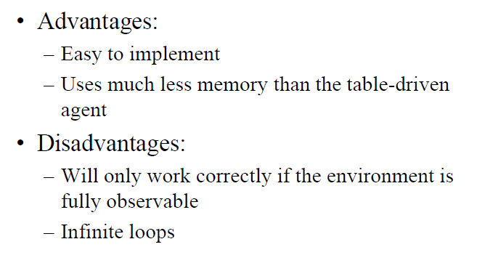
•

Slide 39
Model-Based Reflex Agent
An internal state maintains important information from previous percepts
  sensors only provide a partial picture of the environment
  helps with some partially observable environments
The internal states reflects the agent’s knowledge about the world
  this knowledge is called a model
  may contain information about changes in the world
    caused by actions of the action
    independent of the agent’s behavior

Slide 40
Model-Based Reflex Agent Diagram
Sensors
State
What the world is like now
How the world evolves
What my actions do
Condition-action rules
Agent
What should I do now
Actuators
Environment

Slide 41
Model-Based Reflex Agent Program
Application of simple rules to situations
function REFLEX-AGENT-WITH-STATE(percept) returns action
static: rules //set of condition-action rules
state //description of the current world state
action //most recent action, initially none
state := UPDATE-STATE(state, action, percept)
rule := RULE-MATCH(state, rules)
action := RULE-ACTION[rule]
return action

Slide 42
Goal-Based Agent
The agent tries to reach a desirable state, the goal
  may be provided from the outside (user, designer, environment), or inherent to the agent itself
Results of possible actions are considered with respect to the goal
  easy when the results can be related to the goal after each action
  in general, it can be difficult to attribute goal satisfaction results to individual actions
  may require consideration of the future
    what-if scenarios
    search, reasoning or planning
Very flexible, but not very efficient

Slide 43
Goal-Based Agent Diagram
Sensors
State
What the world is like now
How the world evolves
What happens if I do an action
What my actions do
Goals
Agent
What should I do now
Actuators
Environment

Slide 44
Utility-Based Agent
They choose actions based on a preference (utility) for each state. Goals are inadequate when −
What if there are many paths to the goal?
•Utility measures which states are preferable to other state
There are conflicting goals, out of which only few can be achieved.
Goals have some uncertainty of being achieved and you need to weigh likelihood of success against the importance of a goal.
More sophisticated distinction between different world states
  a utility function maps states onto a real number
    may be interpreted as “degree of happiness”
  permits rational actions for more complex tasks
    resolution of conflicts between goals (tradeoff)
    multiple goals (likelihood of success, importance)
    a utility function is necessary for rational behavior, but sometimes it is not made explicit

Slide 45
Utility-Based Agent Diagram
Sensors
State
What the world is like now
How the world evolves
What happens if I do an action
What my actions do
How happy will I be then
Utility
Goals
What should I do now
Agent
Actuators
Environment

Slide 46
Learning Agent
performance element
  selects actions based on percepts, internal state, background knowledge
  can be one of the previously described agents
learning element
  identifies improvements
critic
  provides feedback about the performance of the agent
  can be external; sometimes part of the environment
problem generator
  suggests actions
  required for novel solutions (creativity

Slide 47
Learning Agent Diagram
Performance
Standard
Sensors
Critic
State
What the world is like now
Learning
Element
How the world evolves
What happens if I do an action
What my actions do
How happy will I be then
Utility
Problem
Generator
What should I do now
Agent
Actuators
Environment

Slide 48
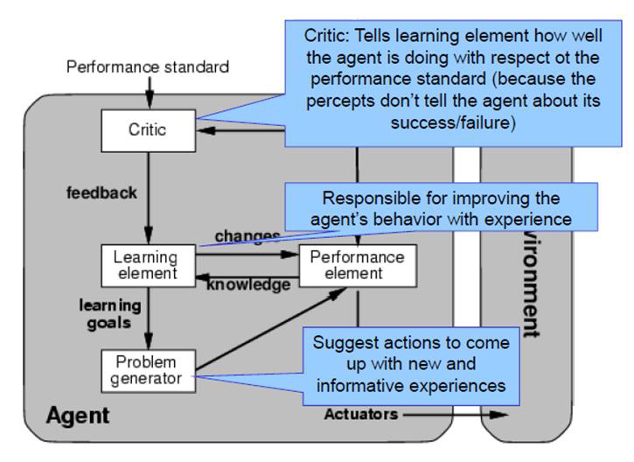

Slide 49
Chapter Summary
Agents perceive and act in an environment
Ideal agents maximize their performance measure
  autonomous agents act independently
Basic agent types
  simple reflex
  reflex with state
  goal-based
  utility-based
  learning
Some environments may make life harder for agents
  inaccessible, non-deterministic, non-episodic, dynamic, continuous

